Slide 1


Team 60: Solar Lighting System
Bi-Weekly Update 2 Josh George, Jeb Malek, Lyric Haylow Sponsor: Dr. Wonhyeok Jang TA: Rhett Guthrie
Notes:
Michelle

Slide 2

Project Summary
A need for clean, renewable sources becomes more apparent than ever.
Our home indoor and outdoor lighting system is the first step towards this, using solar power.
Design an indoor/outdoor home lighting system that operates with a battery, power conversion, mobile application functionality, BT microcontroller for switch automation from motion sensors.
Notes:
Kyle

Slide 3
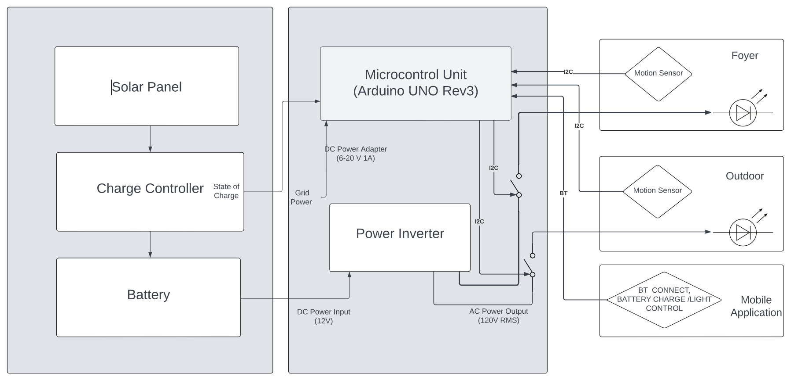
Project/Subsystem Overview
Notes:
Eric

Slide 4
Project Timeline
Subsystem Designs (completed 01/16) | Subsystems ordered and soldered (2/14) | Integration of Bluetooth and Arduino (to complete by 2/21) | Integration of Solar Charge Controller and MCU (3/1) | Final Integration (to complete by 3/15) | System Test (to complete by 3/21) | Validation (to complete by 3/25) | Demo and Report (to complete by 4/1)
Notes:
Eric

Slide 5
Solar Charge Controller
Lyric Haylow
Accomplishments since last update 10 hrs of effort | Ongoing progress/problems and plans until the next presentation
Parts for PCB arrived a week ago PCB board ordered, expected to arrive within 3 days | Solder board when arrives, immediately start testing Working on 3D model for sensor holder and microcontroller enclosure Design board/system for reading battery percentage to Arduino for Bluetooth

Slide 6
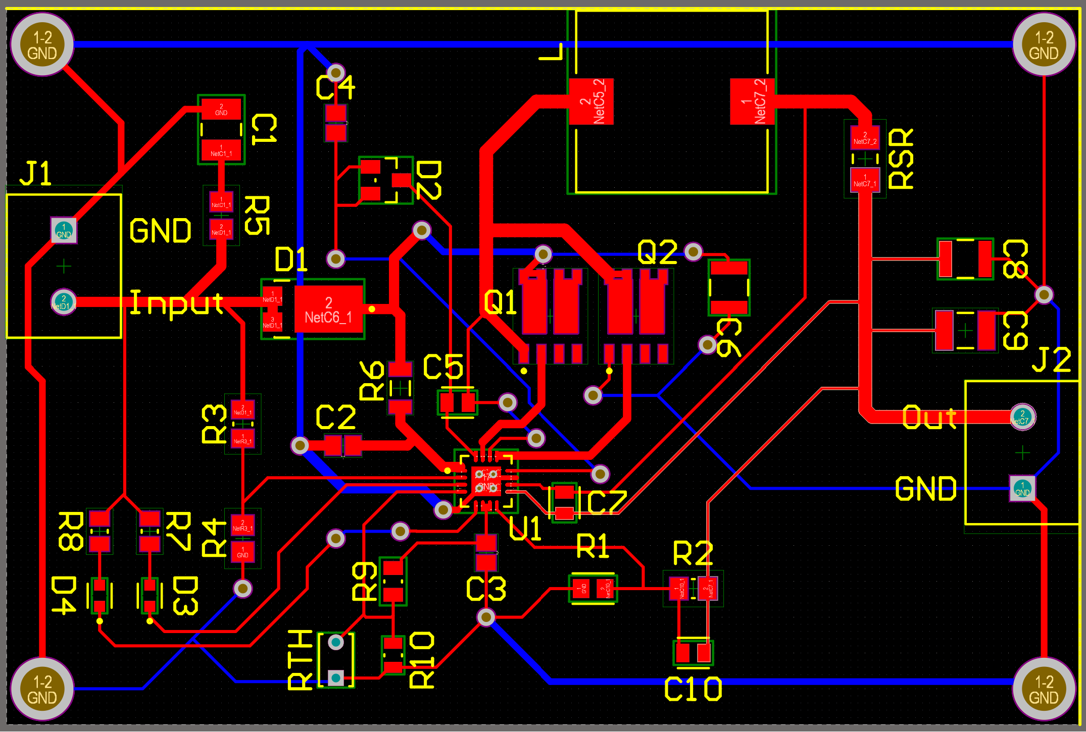
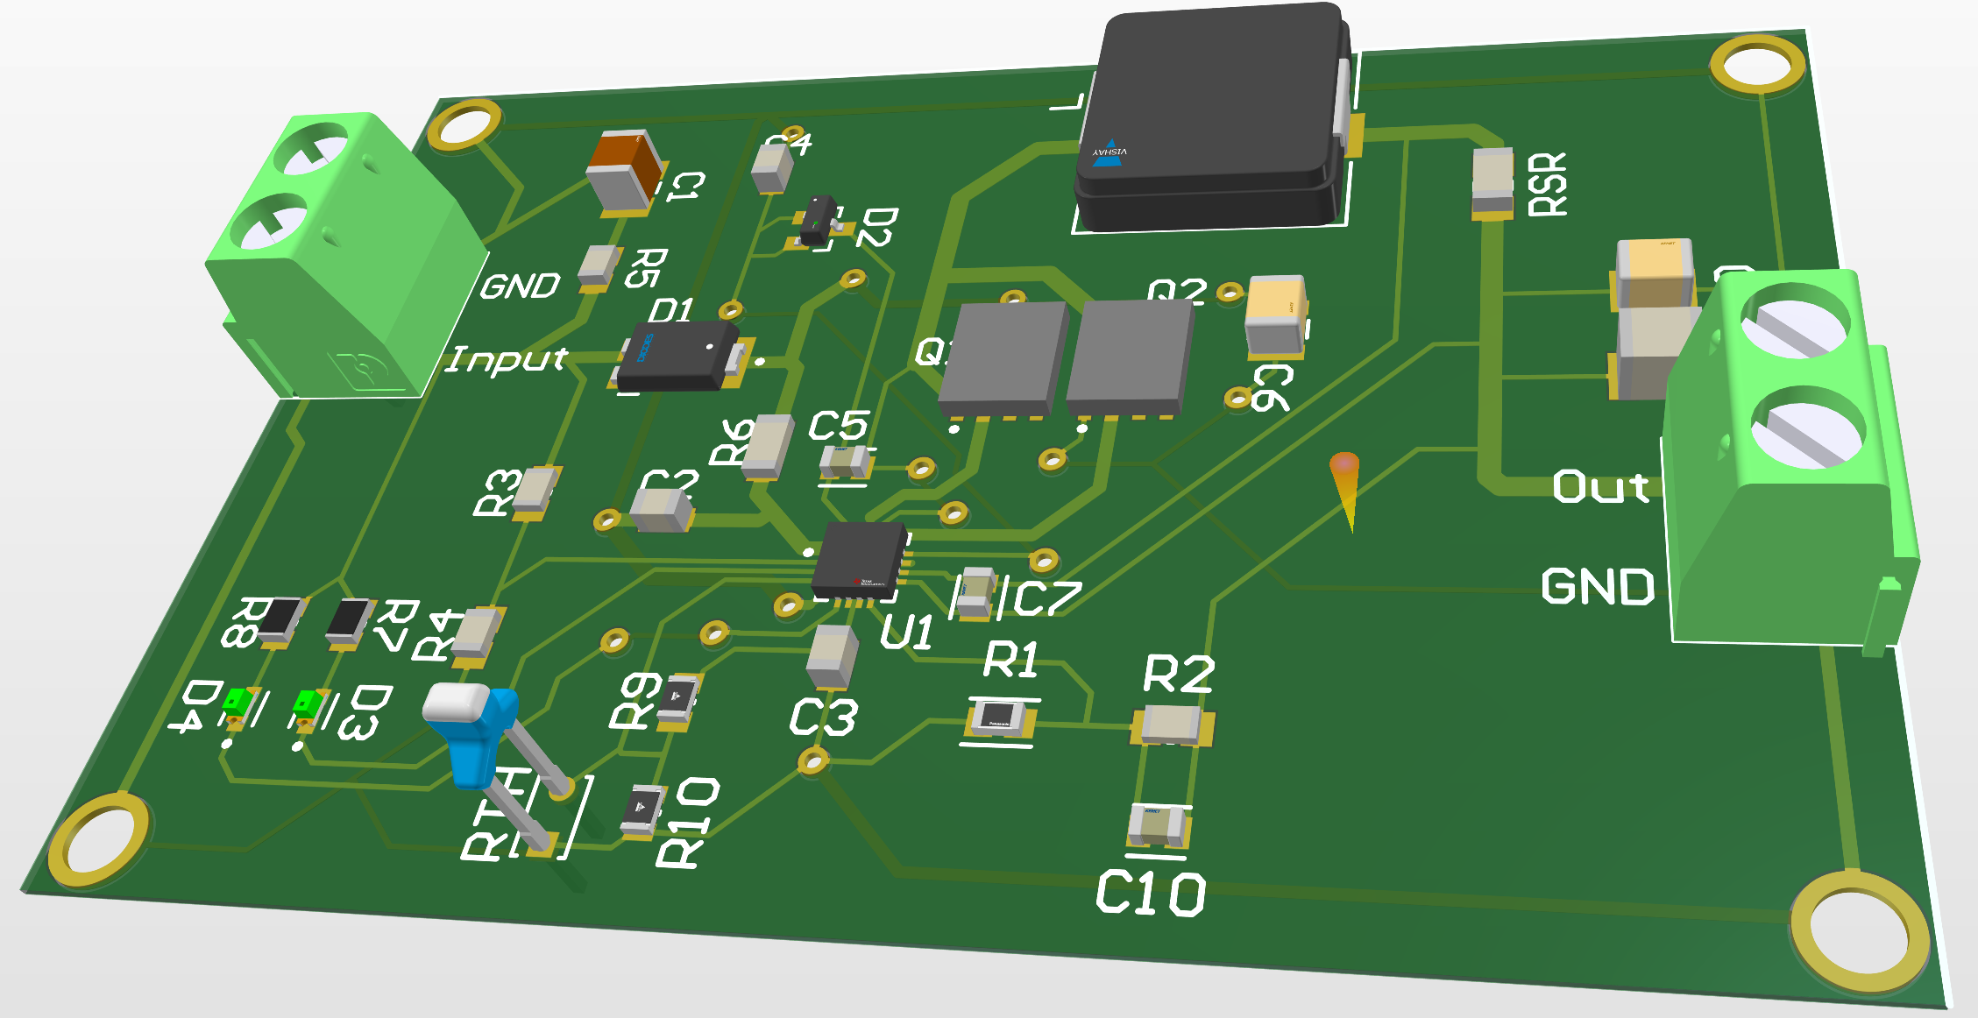
Solar Charge Controller
Lyric Haylow

Slide 7
Inverter Subsystem
Jeb Malek
Accomplishments since 403 25 hrs of effort | Ongoing progress/problems and plans until the next presentation
PCB Assembled dsPIC in-circuit programming Gate drive signal validated Power transformer voltage validated | Testing & Validation of Signal to Switches and Transformer Drivers Apply Battery Power and Check Transformer Voltage Levels Check Output from Full Bridge
Evaluated PWM Timing configuration to avoid shoot through to protect MOSFETs.
Validation of In-Circuit Programming

Slide 8
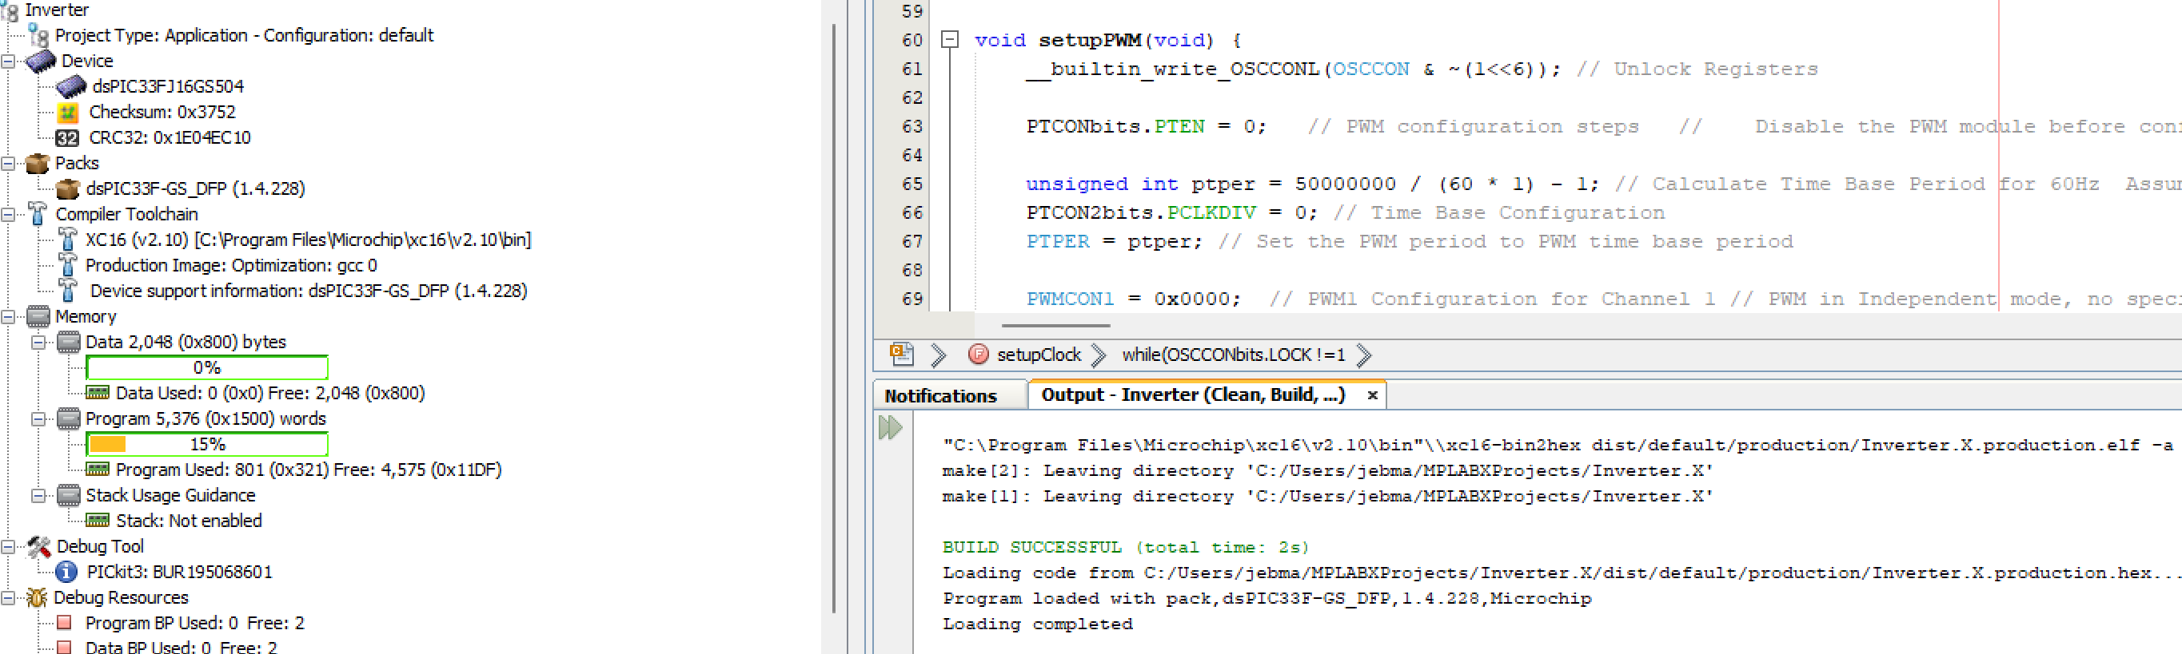
Inverter Subsytem
Jeb Malek
DSPIC33FJ16504 Specifications
Maximum Duty Cycle Resolution 1.04ns
System Clock 50 MHz
Normalized Sine Wave Lookup Table b/t 0 – 1 for Unipolar Switching Function
Timing mechanism: True Independent Mode
`
Verification of MCU Programing

Slide 9
Microcontroller Subsystem
Jeb Malek & Josh George
Accomplishments since 403 25 hrs of effort | Ongoing progress/problems and plans until the next presentation
Relays Ordered Passive Infared (PIR) Sensors Ordered Light Cord & Socket Ordered Verified connection for Arduino MCU Programming | Testing of Sensor proximity & distance Testing of Relay Communication with Arduino Testing of Relay with Light Load
Evaluated Sensor Communication of requirements for Arduino
Body Sensor Signal High at 150uA
Future Test Light Bulbs with Socket and begin design of demonstration structuring

Slide 10
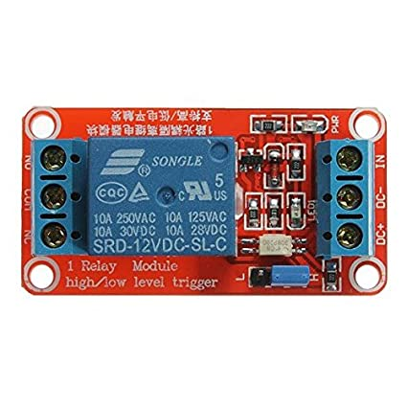
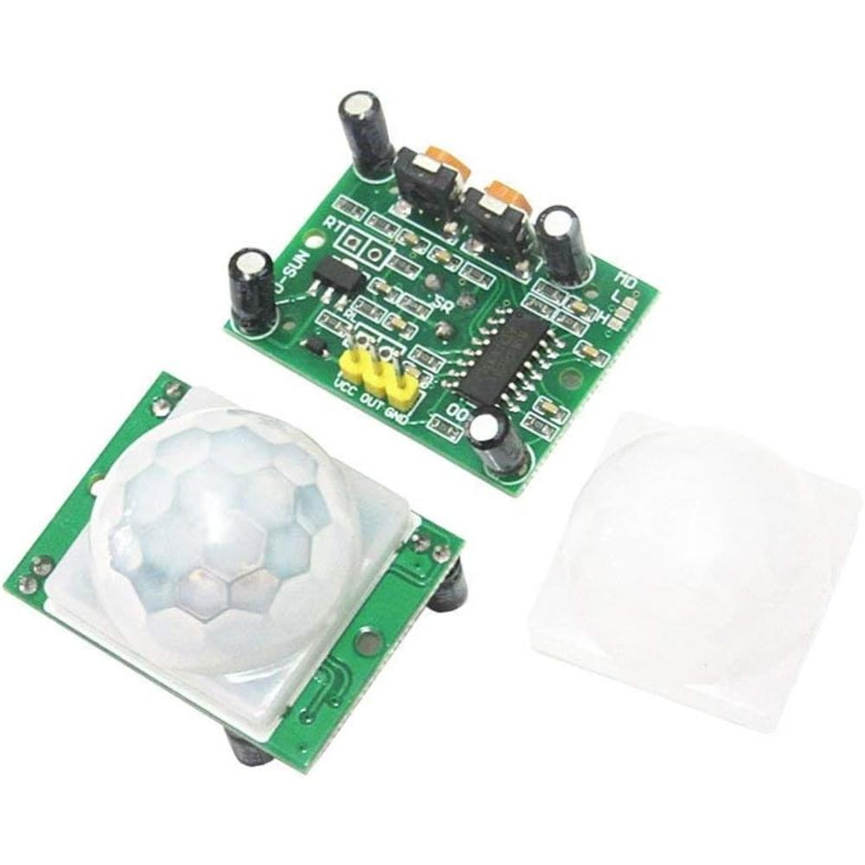
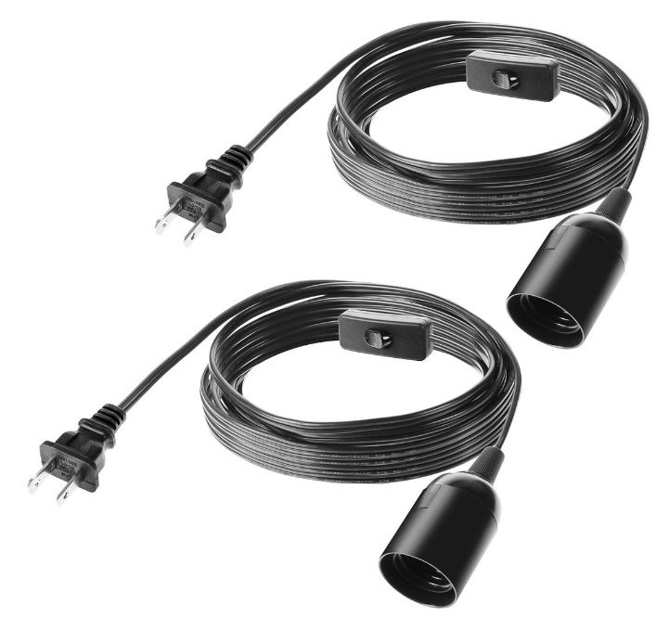
Microcontroller Subsytem
Jeb Malek & Josh George
PIR Motion Sensor
HC--SR501
Operating Voltage: 4.5 – 20V
Delay time: 5-18S
Block time: 2.5S
Microcontrolled Solid State Relay
Rated: 10 Amps
Light Socket
Rated: 375 W
E26 E27 Bulbs
Switch for Manual Testing

Slide 11
Mobile Application
Josh George
Accomplishments since last update 10 hrs of effort | Ongoing progress/problems and plans until the next presentation
-Added Bluetooth screen listing available devices -Finalized Bluetooth connection to Arduino R3 -Implemented rotation of app | -Begin coding microcontroller -Decide pin inputs and outputs

Slide 12
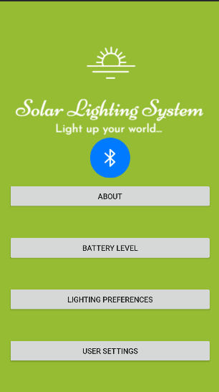
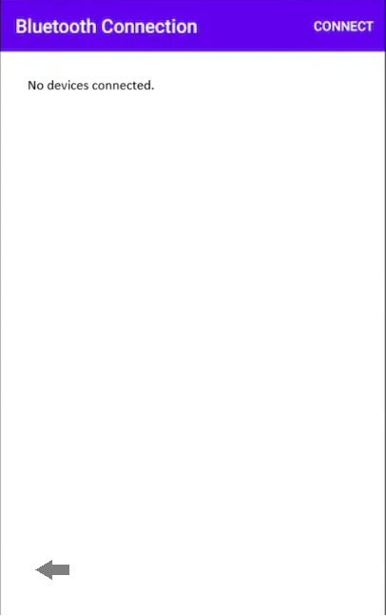
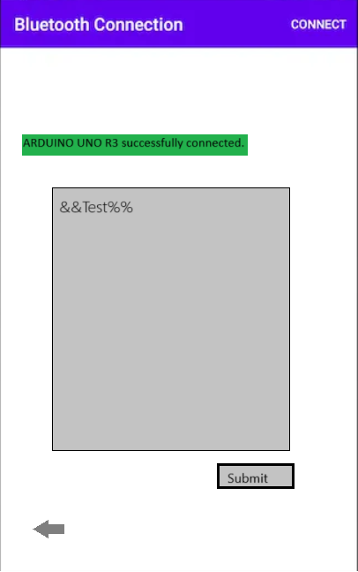
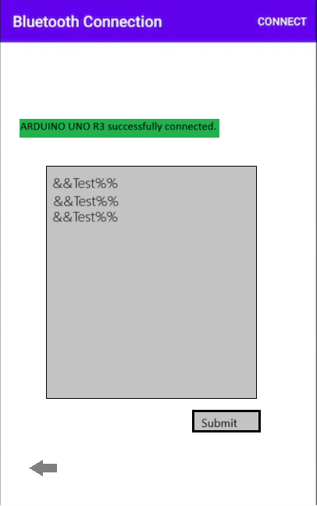
Mobile Application
Josh George

Slide 13
Parts Ordering Status
Full Part Shipment for Inverter expected : Week of 2/5
Parts for new Charge Controller PCB arrived.
Final Parts for preliminary version Inverter
Sensors need to be ordered.
Sensors, relays, and sockets are ordered, ETA roughly one week.
Notes:
Michelle

Slide 14
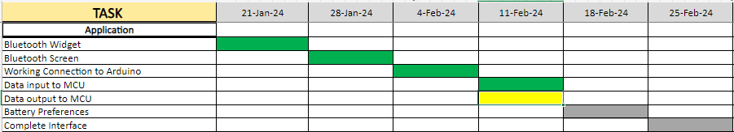
Execution Plan

Slide 15
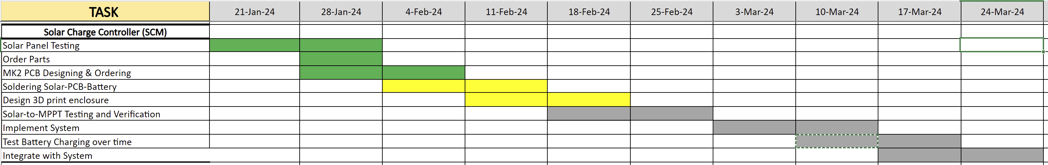
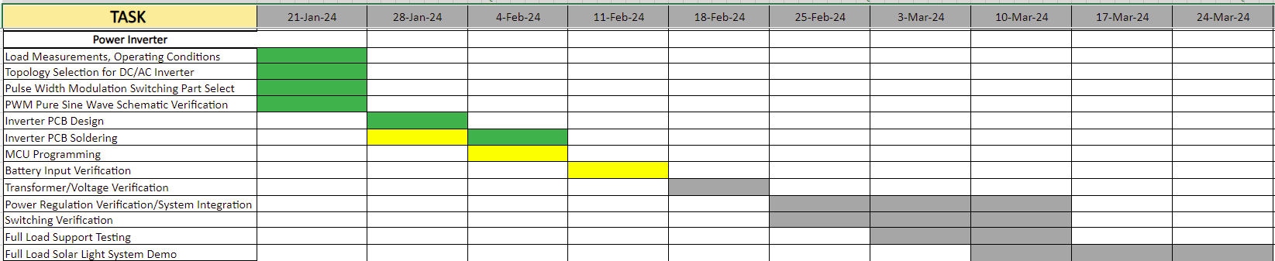
Execution Plan

Slide 16
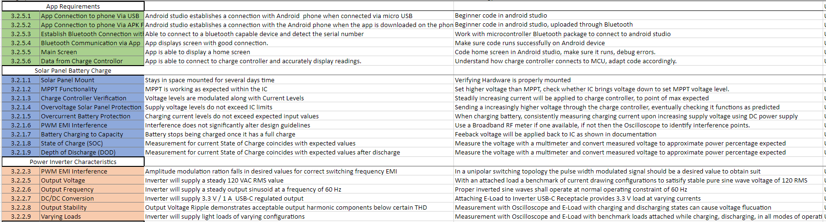
Validation

Slide 17
Thank you , 404 Classmates

